Slide 1
Service Mesh
Kubernetes on AWS
version 0.4

Slide 2
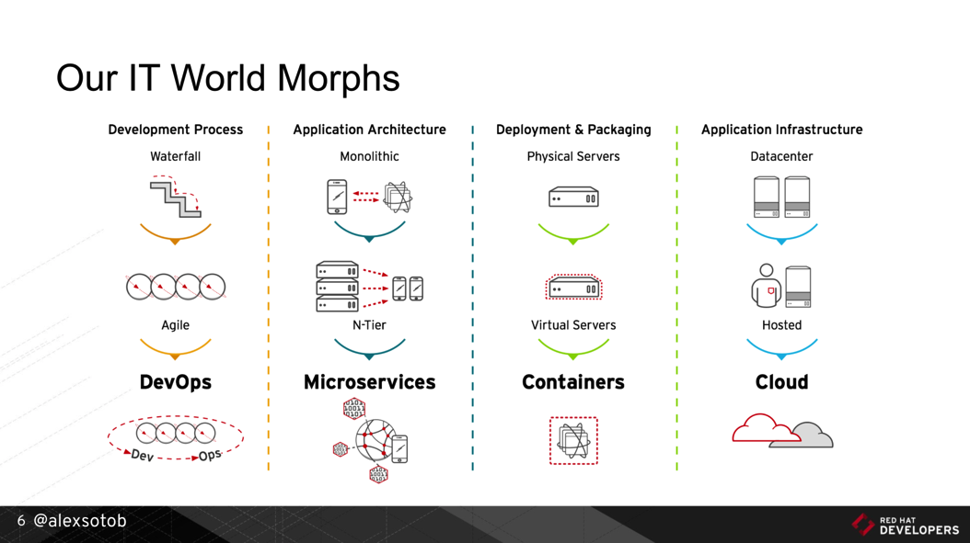
1. Digital Transformation: IT World is changing
https://www.slideshare.net/asotobu/sail-in-the-cloud

Slide 3
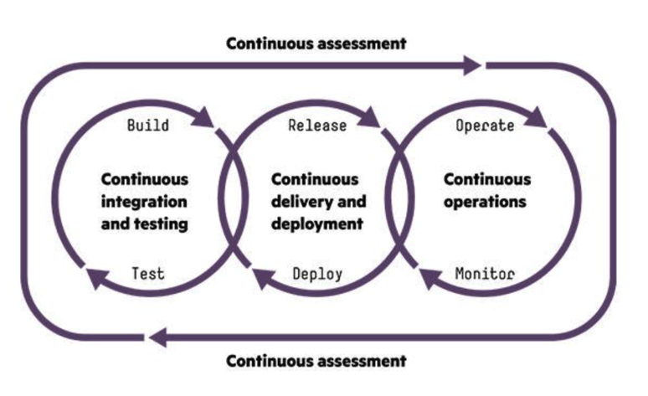
1. Digital Transformation: CI/CD, DevOps, Jenkins,..
https://www.slideshare.net/asotobu/sail-in-the-cloud

Slide 4
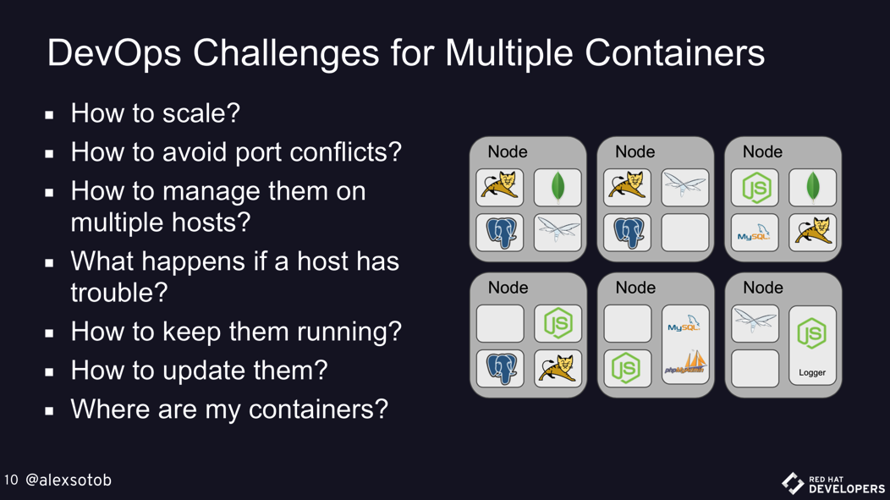
1. Digital Transformation: New challenges
https://www.slideshare.net/asotobu/sail-in-the-cloud

Slide 5
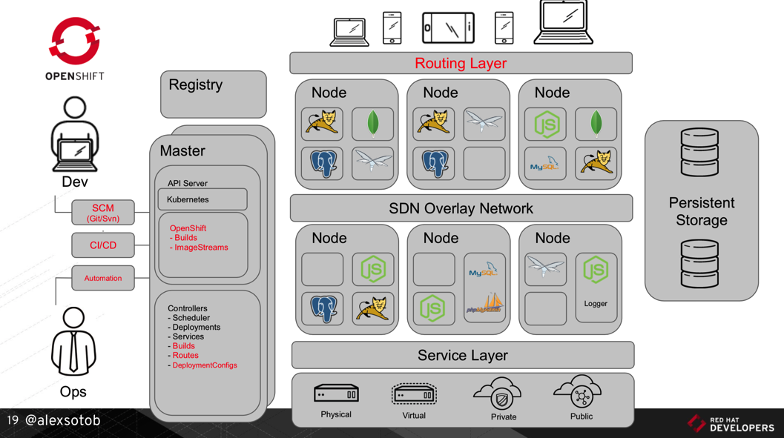
1. Digital Transformation: New Platform
https://www.slideshare.net/asotobu/sail-in-the-cloud

Slide 6
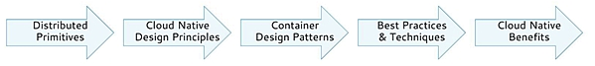
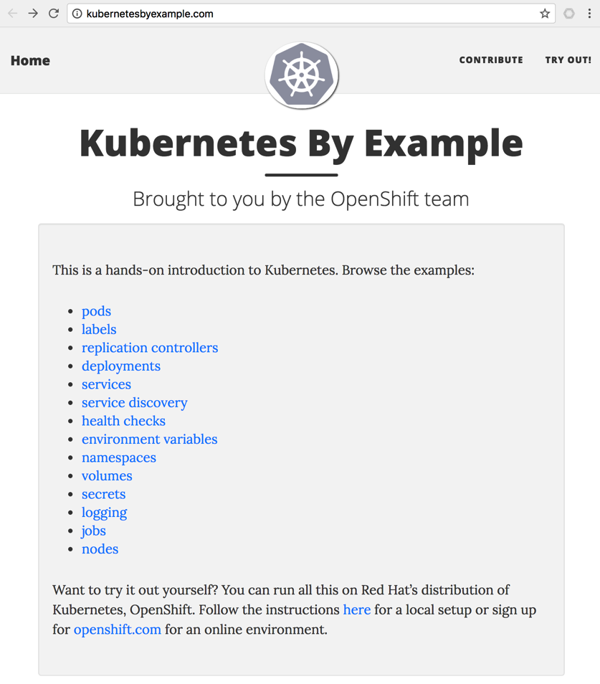
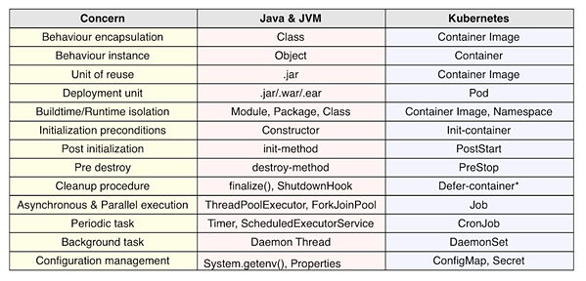
2. Kubernetes effect on the SDLC: Primitives (1/2)
https://www.infoq.com/articles/kubernetes-effect

Slide 7
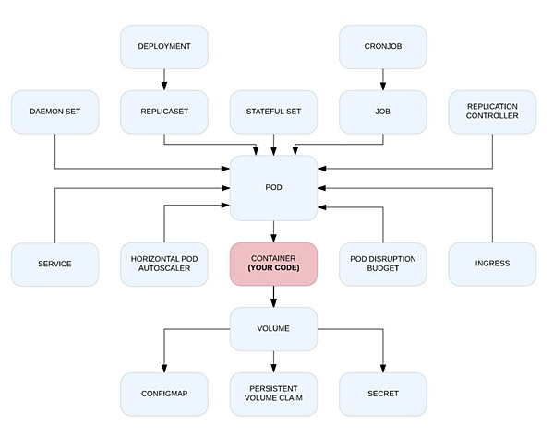
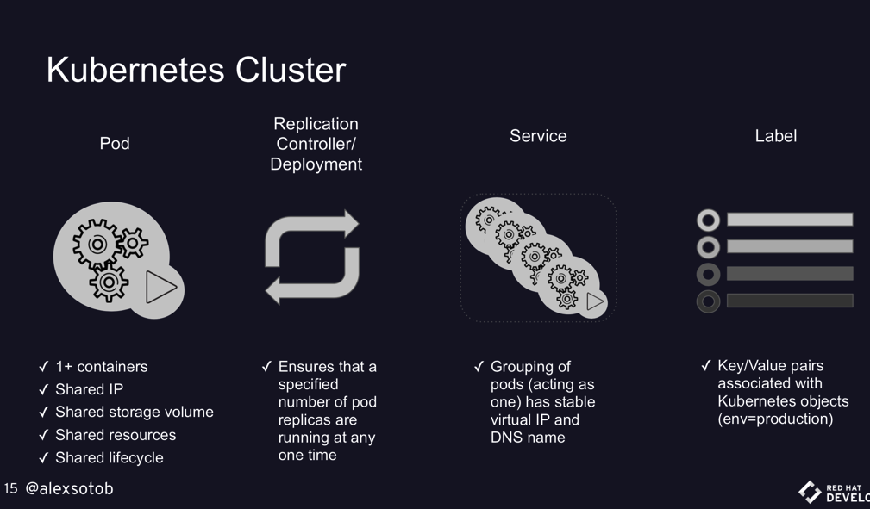
2. Kubernetes effect on the SDLC: Primitives (2/2)
https://www.infoq.com/articles/kubernetes-effect
https://www.slideshare.net/asotobu/sail-in-the-cloud

Slide 8
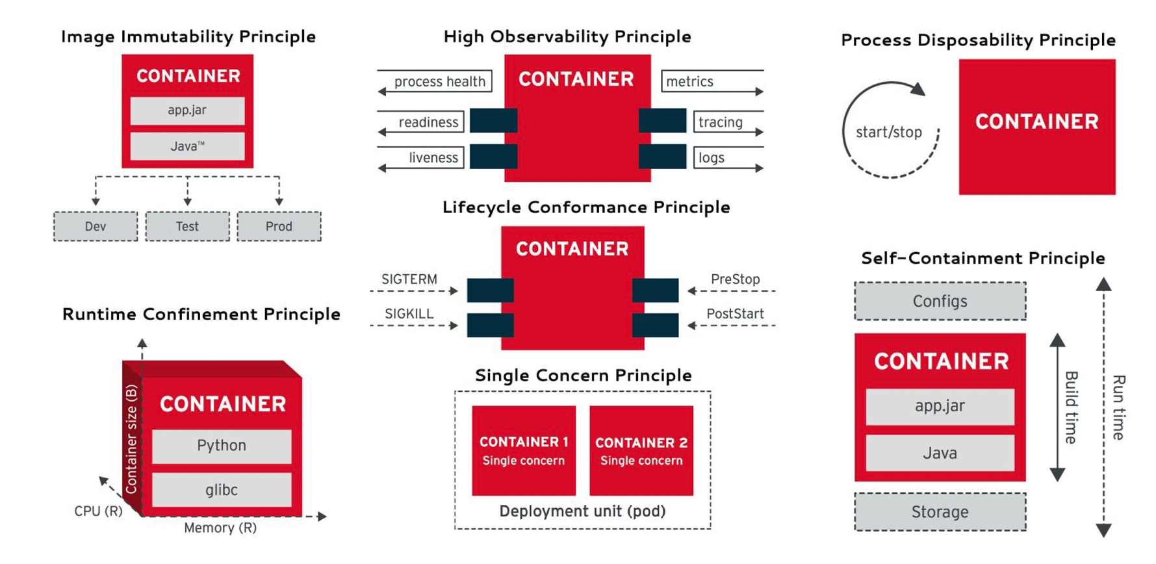
2. Kubernetes effect on the SDLC: Principles
https://www.infoq.com/articles/kubernetes-effect

Slide 9
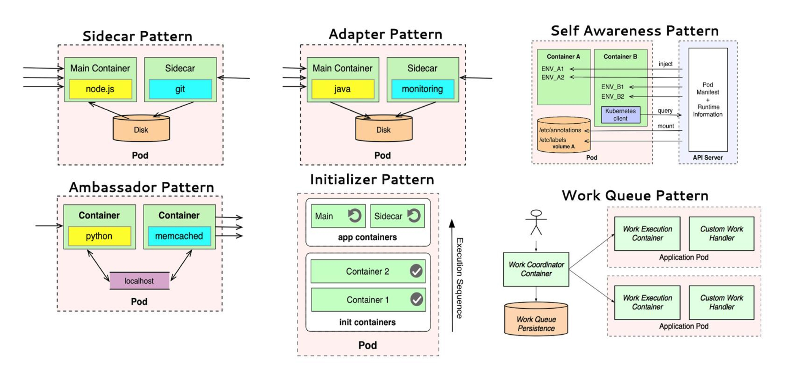
2. Kubernetes effect on the SDLC: Patterns
https://www.infoq.com/articles/kubernetes-effect

Slide 10
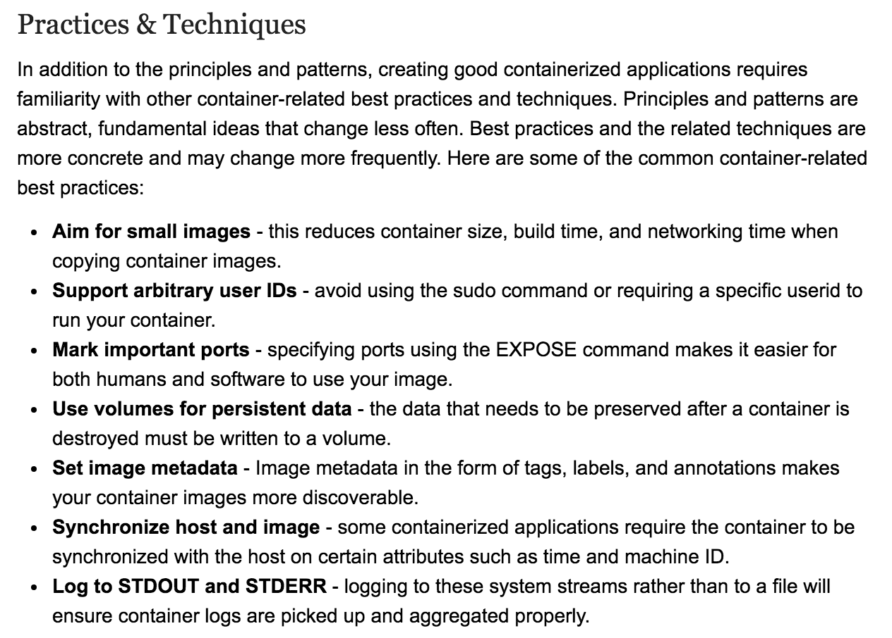
2. Kubernetes effect on the SDLC: Best Practices
https://www.infoq.com/articles/kubernetes-effect

Slide 11
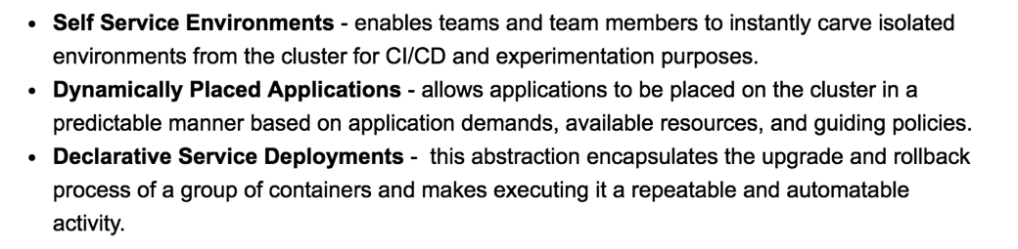
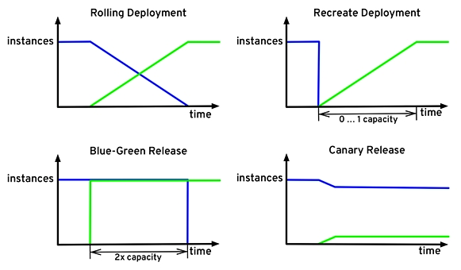
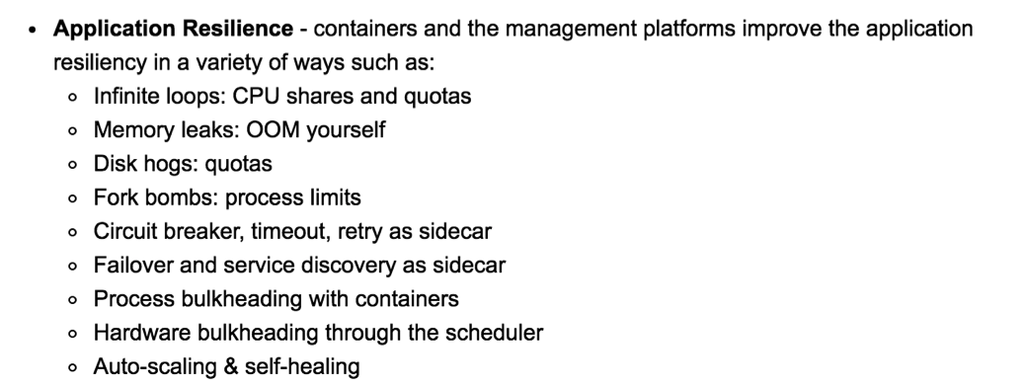
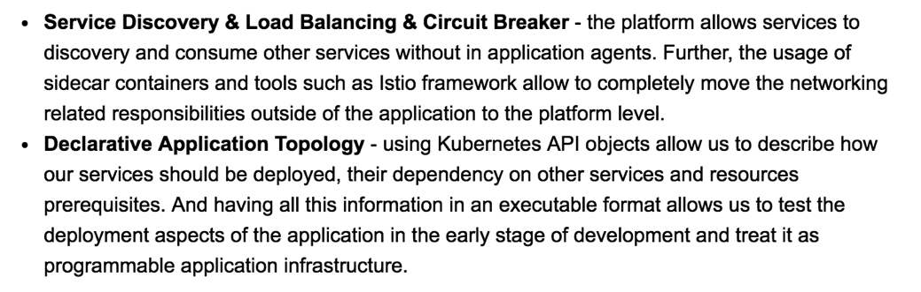
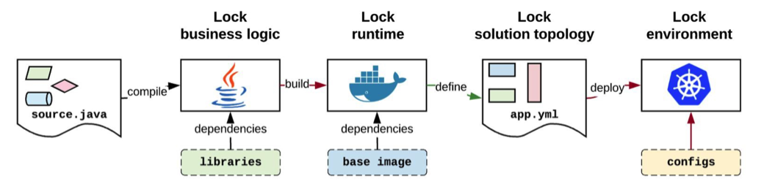
2. Kubernetes effect on the SDLC: Benefits
https://www.infoq.com/articles/kubernetes-effect

Slide 12


3. Lab 01: Delivering Services on Kubernetes 1/3
Amazon EC2
Kubernetes
Node₁
Edge Proxy
(Load Balancer)
Port₁
LoadBalancer
http://PublicIP₁:Port_{pub1}
nodePort₁
Pod₁
Docker₁
Docker Registry
Port₂: 5002
NodePort
nodePort₂
(hello-svc-np)
5000
(hello-v1)
Node₂
Port₃
ClusterIP
Pod₂
nodePort₃: --
Docker₂
5000
(hello-v2)
curl <clusterIP>:<nodePort>/hello
Services
Deployment
## scheduling step by step
$ kubectl apply –f labs/kube/01-delivering-on-k8s/hello-ns-sa.yaml
$ kubectl apply –f labs/kube/01-delivering-on-k8s/hello-deployment.yaml
$ kubectl apply –f labs/kube/01-delivering-on-k8s/hello-services.yaml
## scheduling all together
$ kubectl apply –f labs/kube/01-delivering-on-k8s/hello-all.yaml

Slide 13
3. Lab 01: Delivering Services on Kubernetes 2/3
---
apiVersion: v1
kind: Namespace
metadata:
name: hello-ns
---
apiVersion: v1
kind: ServiceAccount
metadata:
name: hello-sa
namespace: hello-ns
---
apiVersion: extensions/v1beta1
kind: Deployment
metadata:
name: hello-v1
namespace: hello-ns
spec:
replicas: 1
template:
metadata:
labels:
app: hello
version: v1
spec:
serviceAccountName: hello-sa
containers:
- name: helloworld
image: istio/examples-helloworld-v1
imagePullPolicy: IfNotPresent
ports:
- containerPort: 5000
---
apiVersion: extensions/v1beta1
kind: Deployment
metadata:
name: hello-v2
namespace: hello-ns
spec:
replicas: 1
template:
metadata:
labels:
app: hello
version: v2
spec:
serviceAccountName: hello-sa
containers:
- name: helloworld
image: istio/examples-helloworld-v2
imagePullPolicy: IfNotPresent
ports:
- containerPort: 5000
---
apiVersion: v1
kind: Service
metadata:
name: hello-svc-np
labels:
app: hello
namespace: hello-ns
spec:
type: NodePort
ports:
- name: http
port: 5002
targetPort: 5000
selector:
app: hello

Slide 14
3. Lab 01: Delivering Services on Kubernetes 3/3
$ kubectl get pods -n hello-ns -o wide
NAME READY STATUS RESTARTS AGE IP NODE
hello-v1-7ccbf86948-n7vgc 1/1 Running 0 2h 100.96.1.25 ip-10-10-121-30.us-east-2.compute.internal
hello-v2-d6c95b4b6-dg4qk 1/1 Running 0 2h 100.96.2.41 ip-10-10-59-129.us-east-2.compute.internal
$ kubectl describe svc/hello-svc-np -n hello-ns
Name: hello-svc-np
Namespace: hello-ns
Labels: app=hello
Annotations: kubectl.kubernetes.io/last-applied-configuration={"apiVersion":"v1","kind":"Service”,...
Selector: app=hello
Type: NodePort
IP: 100.69.226.216
Port: http 5002/TCP
TargetPort: 5000/TCP
NodePort: http 30764/TCP
Endpoints: 100.96.1.25:5000,100.96.2.41:5000
Session Affinity: None
External Traffic Policy: Cluster
Events: <none>
$ kubectl exec -n hello-ns hello-v1-7ccbf86948-n7vgc -- curl -s 100.69.226.216:5002/hello
Hello version: v1, instance: hello-v1-7ccbf86948-n7vgc
$ kubectl exec -n hello-ns hello-v1-7ccbf86948-n7vgc -- curl -s 100.69.226.216:5002/hello
Hello version: v2, instance: hello-v2-d6c95b4b6-dg4qk
$ kubectl logs hello-v1-7ccbf86948-n7vgc -n hello-ns –f
$ kubectl logs hello-v2-d6c95b4b6-dg4qk -n hello-ns –f
$ kubectl logs -l app=hello -n hello-ns
* Running on http://0.0.0.0:5000/ (Press CTRL+C to quit)
100.96.1.1 - - [13/Feb/2018 15:38:13] "GET /hello HTTP/1.1" 200 -
* Running on http://0.0.0.0:5000/ (Press CTRL+C to quit)
100.96.1.25 - - [13/Feb/2018 15:38:16] "GET /hello HTTP/1.1" 200 –

Slide 15
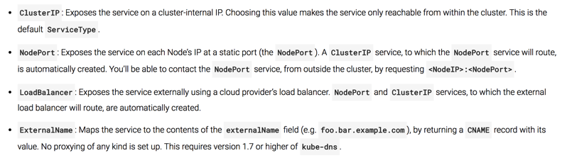
4. Lab 02: Exposing Services - Ingress 1/4
Amazon EC2
Edge Proxy
(Load Balancer)
Kubernetes
Node₁
Port₁: 81, CIP₁
Services
LoadBalancer
http://PublicIP₁:Port_{pub1}
Pod₁
Ingress Controller
nodePort₁
Docker₁
http://PublicIP₂:Port_{pub2}
Port₂: 82, CIP₂
NodePort
nodePort₂
8080
Route <http>://<IP>:<Port>/<Path>
To CIP₂:Port₂
Port₃: 83, CIP₃
ClusterIP
nodePort₃: --
Kubernetes
Node₂
Pod₂
Docker₂
8080
External Network
spec.loadBalancerIp:spec.pops[*].port
Internal Network (Backend)
<NodeIP>:spec.ports[*].nodePort
spec.clusterIp:spec.ports[*].port

Slide 16
4. Lab 02: Exposing Services – Ingress 2/4
---
apiVersion: v1
kind: Namespace
metadata:
name: echoserver-ns
---
apiVersion: v1
kind: ServiceAccount
metadata:
name: echoserver-sa
namespace: echoserver-ns
---
apiVersion: extensions/v1beta1
kind: Deployment
metadata:
name: echo-pod
namespace: echoserver-ns
spec:
replicas: 1
template:
metadata:
labels:
app: echo-docker-tpl
spec:
serviceAccountName: echoserver-sa
containers:
- name: echo-docker
image: gcr.io/google_containers/echoserver:1.4
imagePullPolicy: IfNotPresent
ports:
- containerPort: 8080
---
apiVersion: v1
kind: Service
metadata:
name: echo-svc-lb
labels:
app: echo-svc-lb-label
namespace: echoserver-ns
spec:
type: LoadBalancer
ports:
- name: http
port: 81
targetPort: 8080
#nodePort: 30001 # valid range of ports is 30000-32767
selector:
app: echo-docker-tpl
---
apiVersion: v1
kind: Service
metadata:
name: echo-svc-np
labels:
app: echo-svc-np-label
namespace: echoserver-ns
spec:
type: NodePort
ports:
- name: http
port: 82
targetPort: 8080
#nodePort: 30001 # valid range of ports is 30000-32767
selector:
app: echo-docker-tpl
## scheduling all together
$ kubectl apply –f labs/kube/02-ingress/echoserve-app.yaml

Slide 17
4. Lab 02: Exposing Services – Ingress 3/4
---
apiVersion: v1
kind: Service
metadata:
name: echo-svc-ci
labels:
app: echo-svc-ci-label
namespace: echoserver-ns
spec:
type: ClusterIP # it's default
ports:
- name: http
port: 83
targetPort: 8080
#nodePort: 30001 # valid range of ports is 30000-32767
selector:
app: echo-docker-tpl
---
apiVersion: extensions/v1beta1
kind: Ingress
metadata:
name: echo-ing-np
annotations:
kubernetes.io/ingress.class: "nginx"
namespace: echoserver-ns
spec:
backend:
serviceName: echo-svc-np # my default backend
servicePort: 82
rules:
- host: port82.echoserver.local
http:
paths:
- path: /port82
backend:
serviceName: echo-svc-np
servicePort: 82
---
apiVersion: extensions/v1beta1
kind: Ingress
metadata:
name: echo-ing-ci
annotations:
kubernetes.io/ingress.class: "nginx"
namespace: echoserver-ns
spec:
rules:
- host: port83.echoserver.local
http:
paths:
- path: /port83
backend:
serviceName: echo-svc-ci
servicePort: 83
---

Slide 18
4. Lab 02: Exposing Services – Ingress 4/4
$ kubectl get pods -n echoserver-ns
NAME READY STATUS RESTARTS AGE
echo-pod-75786585b5-j752l 1/1 Running 0 4d
$ kubectl get svc -n echoserver-ns
NAME TYPE CLUSTER-IP EXTERNAL-IP PORT(S) AGE
echo-svc-ci ClusterIP 100.70.164.2 <none> 83/TCP 4d
echo-svc-np NodePort 100.67.182.23 <none> 82:32330/TCP 4d
$ kubectl get ingress -n echoserver-ns
NAME HOSTS ADDRESS PORTS AGE
echo-ing-ci port83.echoserver.local ac8db89dc0b5b... 80 1d
echo-ing-np port82.echoserver.local ac8db89dc0b5b... 80 1d
$ kubectl exec -n echoserver-ns echo-pod-75786585b5-j752l curl 100.67.182.23:82/svc82
$ kubectl exec -n echoserver-ns echo-pod-75786585b5-j752l curl 100.70.164.2:83/svc83
$ kubectl logs -f echo-pod-75786585b5-j752l -n echoserver-ns
100.96.2.1 - - [13/Feb/2018:14:32:51 +0000] "GET /svc82 HTTP/1.1" 200 400 "-" "curl/7.47.0"
100.96.2.1 - - [13/Feb/2018:14:33:06 +0000] "GET /svc83 HTTP/1.1" 200 402 "-" "curl/7.47.0"
$ kubectl get ingress -n echoserver-ns -o wide
NAME HOSTS ADDRESS PORTS AGE
echo-ing-ci port83.echoserver.local ac8db89dc0b5b11e897330227edf5f86-1217226370.us-east-2.elb.amazonaws.com 80 1d
echo-ing-np port82.echoserver.local ac8db89dc0b5b11e897330227edf5f86-1217226370.us-east-2.elb.amazonaws.com 80 1d
$ curl -v ac8db89dc0b5b11e897330227edf5f86-1217226370.us-east-2.elb.amazonaws.com/port82 -H 'Host: port82.echoserver.local'
$ curl -v ac8db89dc0b5b11e897330227edf5f86-1217226370.us-east-2.elb.amazonaws.com/port83 -H 'Host: port83.echoserver.local'
$ curl -v ac8db89dc0b5b11e897330227edf5f86-1217226370.us-east-2.elb.amazonaws.com -H 'Host: port82.echoserver.local'
$ curl -v ac8db89dc0b5b11e897330227edf5f86-1217226370.us-east-2.elb.amazonaws.com -H 'Host: port83.echoserver.local'
$ kubectl logs -f nginx-ingress-controller-6bbdcd7799-9x76q -n ingress-nginx
... - [...] - - [...] "GET /port82 HTTP/1.1" 200 566 "-" "curl/7.54.0" 196 0.003 [echoserver-ns-echo-svc-np-82] 100.96.2.37:8080 ... 200
... - [...] - - [...] "GET /port83 HTTP/1.1" 200 566 "-" "curl/7.54.0" 196 0.003 [echoserver-ns-echo-svc-ci-83] 100.96.2.37:8080 ... 200
... - [...] - - [...] "GET / HTTP/1.1" 200 548 "-" "curl/7.54.0" 190 0.002 [echoserver-ns-echo-svc-np-82] 100.96.2.37:8080 ... 200
... - [...] - - [...] "GET / HTTP/1.1" 404 21 "-" "curl/7.54.0" 190 0.003 [upstream-default-backend] 100.96.2.32:8080 ... 404
$ kubectl logs -f echo-pod-75786585b5-j752l -n echoserver-ns
100.96.1.19 - - [13/Feb/2018:14:48:05 +0000] "GET /port82 HTTP/1.1" 200 706 "-" "curl/7.54.0"
100.96.1.19 - - [13/Feb/2018:14:49:57 +0000] "GET /port83 HTTP/1.1" 200 706 "-" "curl/7.54.0"
100.96.1.19 - - [13/Feb/2018:14:50:49 +0000] "GET / HTTP/1.1" 200 687 "-" "curl/7.54.0"

